Slide 1


Data Statistics and Analysis
Part 5
Sample composition and characteristics
Reliability and Validity
Correlation Analysis
Regression Analysis
Hypothesis Test

Slide 2
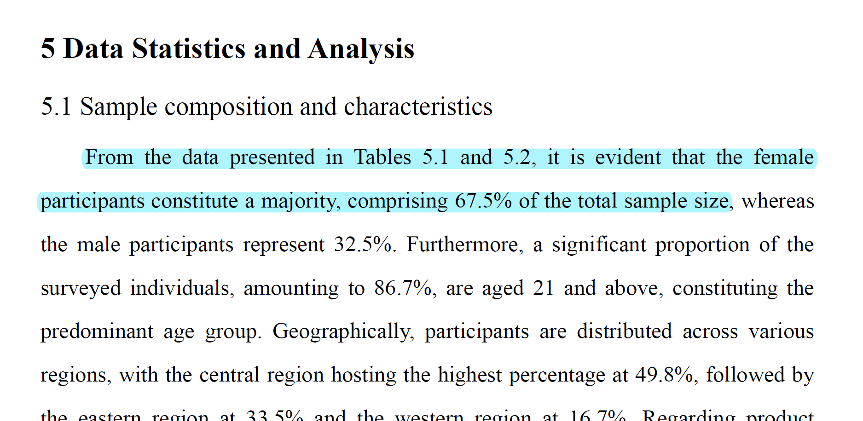
Five writing skills used in this section
Locate the tables and figures where the results can be found
Highlight major results or findings
Provide specific data to support the results or findings
Provide comments(evaluation, comparison and/or explanation) on some of the results
Avoid presenting all the data in the tables or figures and avoid duplicating in the text what as been presented in a table or figure

Slide 3
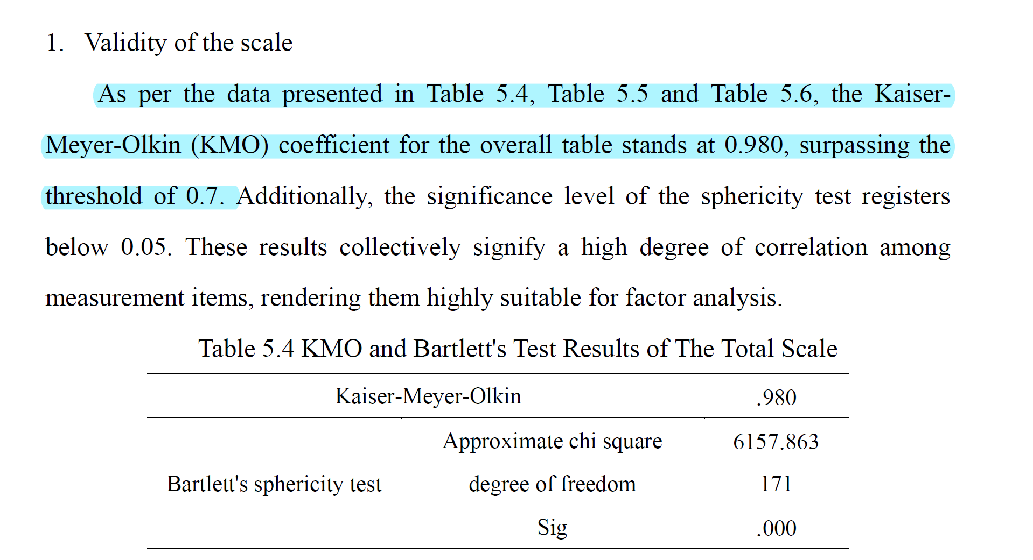
Five writing skills used in this section
Locate the tables and figures where the results can be found
Highlight major results or findings
Provide specific data to support the results or findings
Provide comments(evaluation, comparison and/or explanation) on some of the results
Avoid presenting all the data in the tables or figures and avoid duplicating in the text what as been presented in a table or figure

Slide 4
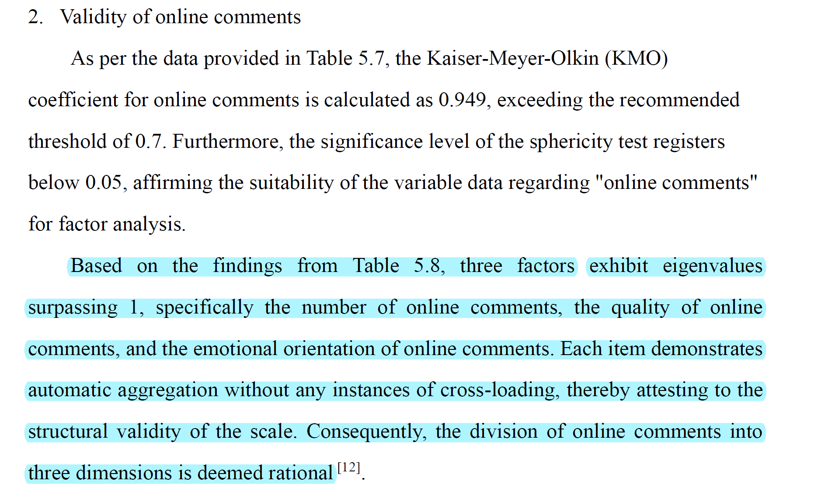
Five writing skills used in this section
Locate the tables and figures where the results can be found
Highlight major results or findings
Provide specific data to support the results or findings
Provide comments(evaluation, comparison and/or explanation) on some of the results
Avoid presenting all the data in the tables or figures and avoid duplicating in the text what as been presented in a table or figure

Slide 5
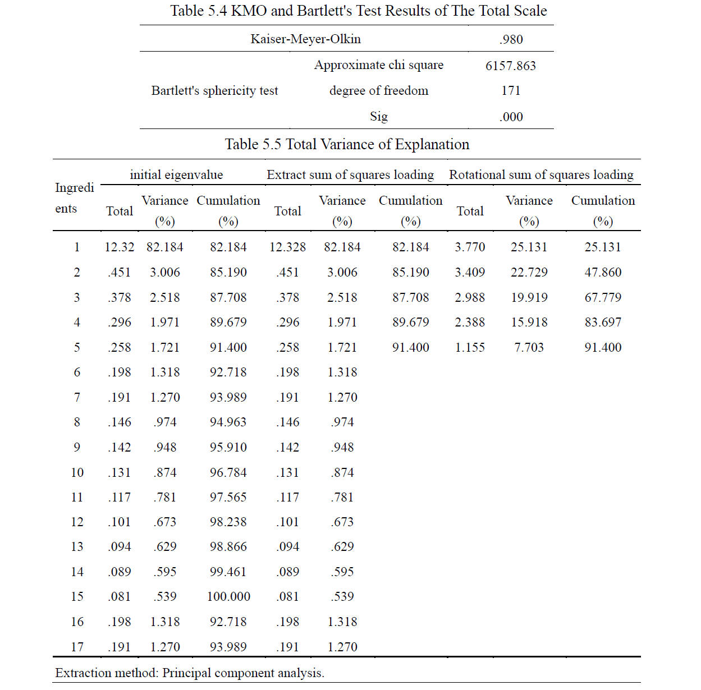
Five writing skills used in this section
Locate the tables and figures where the results can be found
Highlight major results or findings
Provide specific data to support the results or findings
Provide comments(evaluation, comparison and/or explanation) on some of the results
Avoid presenting all the data in the tables or figures and avoid duplicating in the text what as been presented in a table or figure

Slide 6
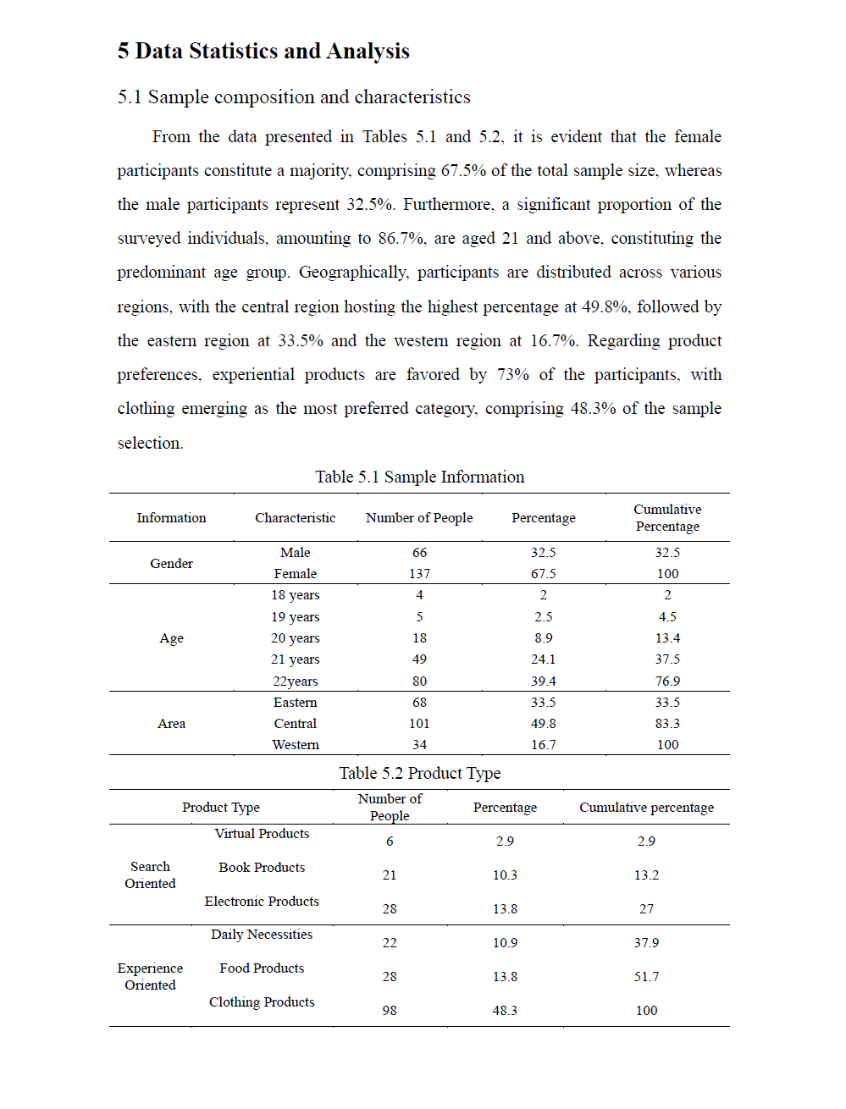
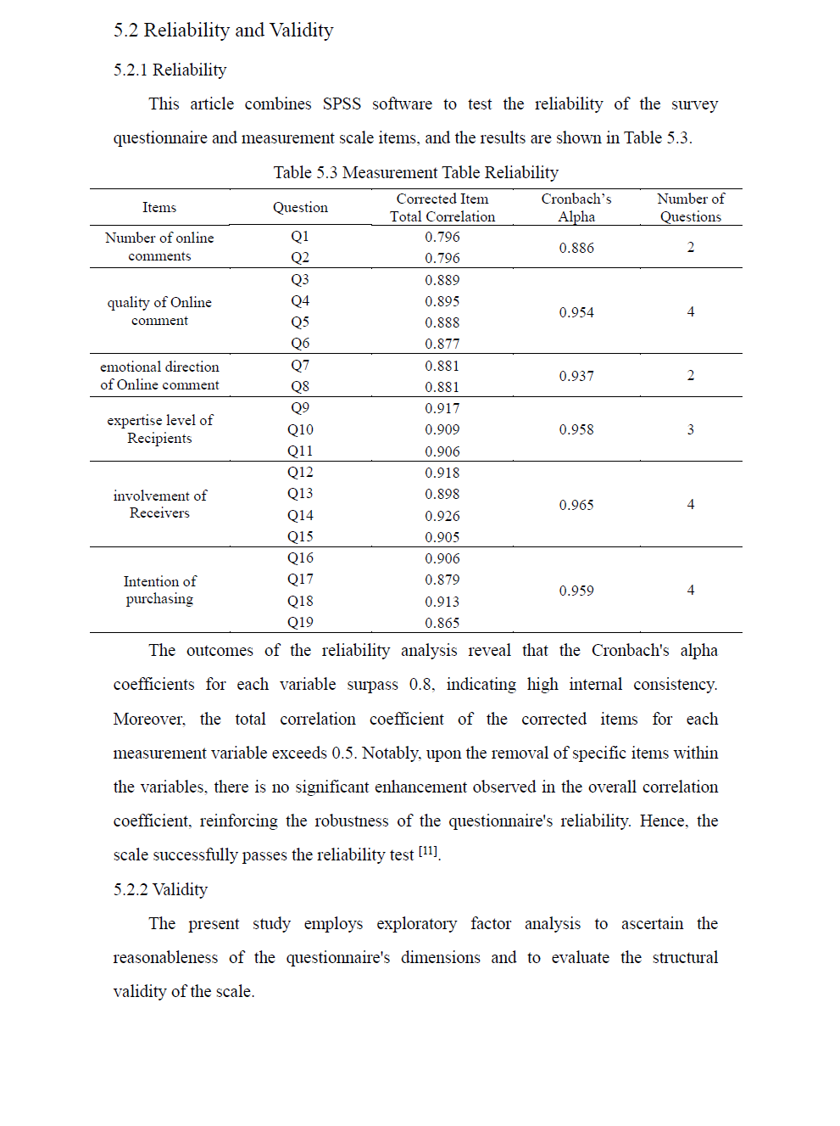
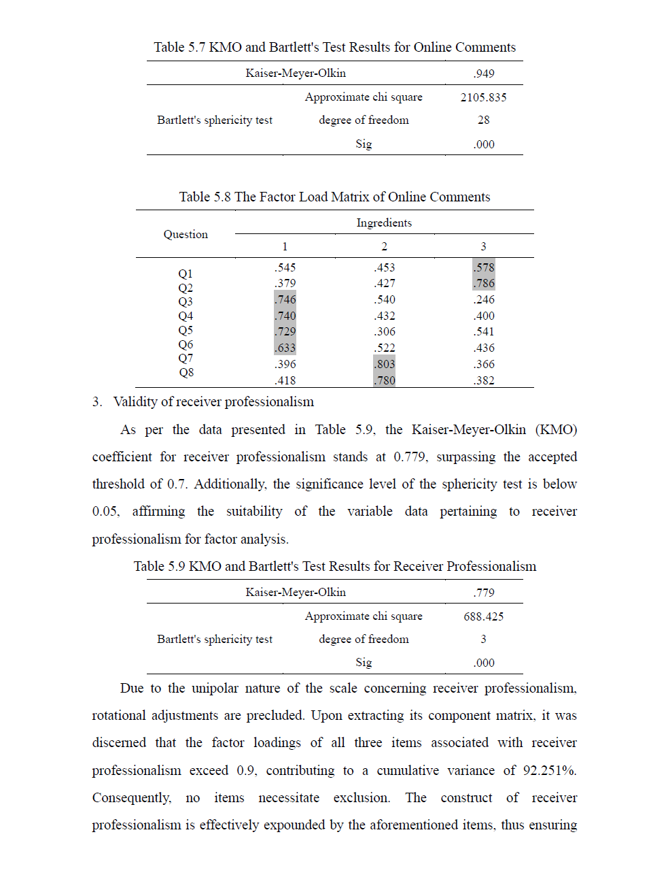
Three suggestions followed in this section
Design and choose the appropriate tables and figures so that the comprehension will be more rapid and the message clearer.
Make figures and tables stand alone. That is, readers could understand the results presented in figures/tables without consulting the written text.
Number and present figures and tables in the order in which they are referred to in the text (figures and tables are number separately). Be sure that each table and figure is cited in the text.

